Slide 1

Branch Diver Lectures

Slide 2
Version History – hidden slide
Version | Date | Who | What changed
2.0 | Sep06 | HQ | Released as Version Sport Diver Lecture 8 – Principles of the Aqualung and Air Endurance
3.0 | Jun11 | HQ | Updated version released
4.0 | Apr14 | Alastair McCulloch | Updated to reflect new Training Schedule with addition of Branch Diver Grade. Lecture renumbered as BDL4 to match the new syllabus and move of Air Endurance topic to BDL5. SSAC changed to ScotSAC throughout. Added hidden version history slide. Email address for feedback added to closing slide. Added footers with Lecture number and Page number to slides.

Slide 3
Lecture BDL4
Principles of the Aqualung

Slide 4
Overview
Principles of the Aqualung
  Cylinder
  Regulator
Cylinder Capacity
Alternative Air Sources

Slide 5
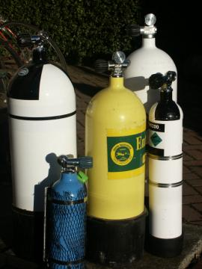
The Cylinder
Steel or Aluminium
Cylinder Markings:
  Manufacturer & Serial Number
  Date of Manufacture (month & year)
  Dates (and types) of Subsequent Tests
  British Standard Number -
    En 1968 : 2002 ; for steel
    En 1802 : 2002 ; for aluminium
  Working Pressure e.g. WP232 Bar
  Test Pressure e.g. TP 348 Bar (1.5 x WP)
  Tear Weight - physical weight of empty cylinder
  Internal Volume of the Cylinder (in Litres)
  e.g. 3L, 7L, 10L, 12L, 15L, 18L
Cylinder Testing
  Visual Inspection - every 2.5 years
  Hydrostatic Testing (also includes a visual) - every 5 years
A cylinder out of test must NEVER be filled
© Dons Dive Store

Slide 6
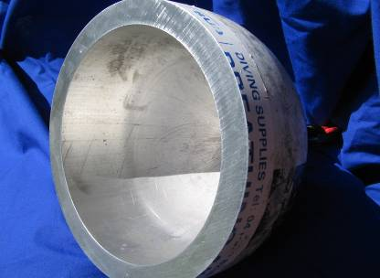
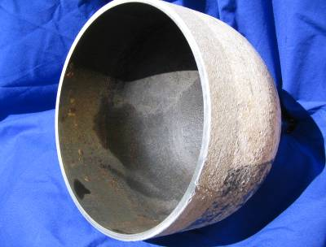
The Cylinder
© Dons Dive Store
© Dons Dive Store
Aluminium Steel

Slide 7
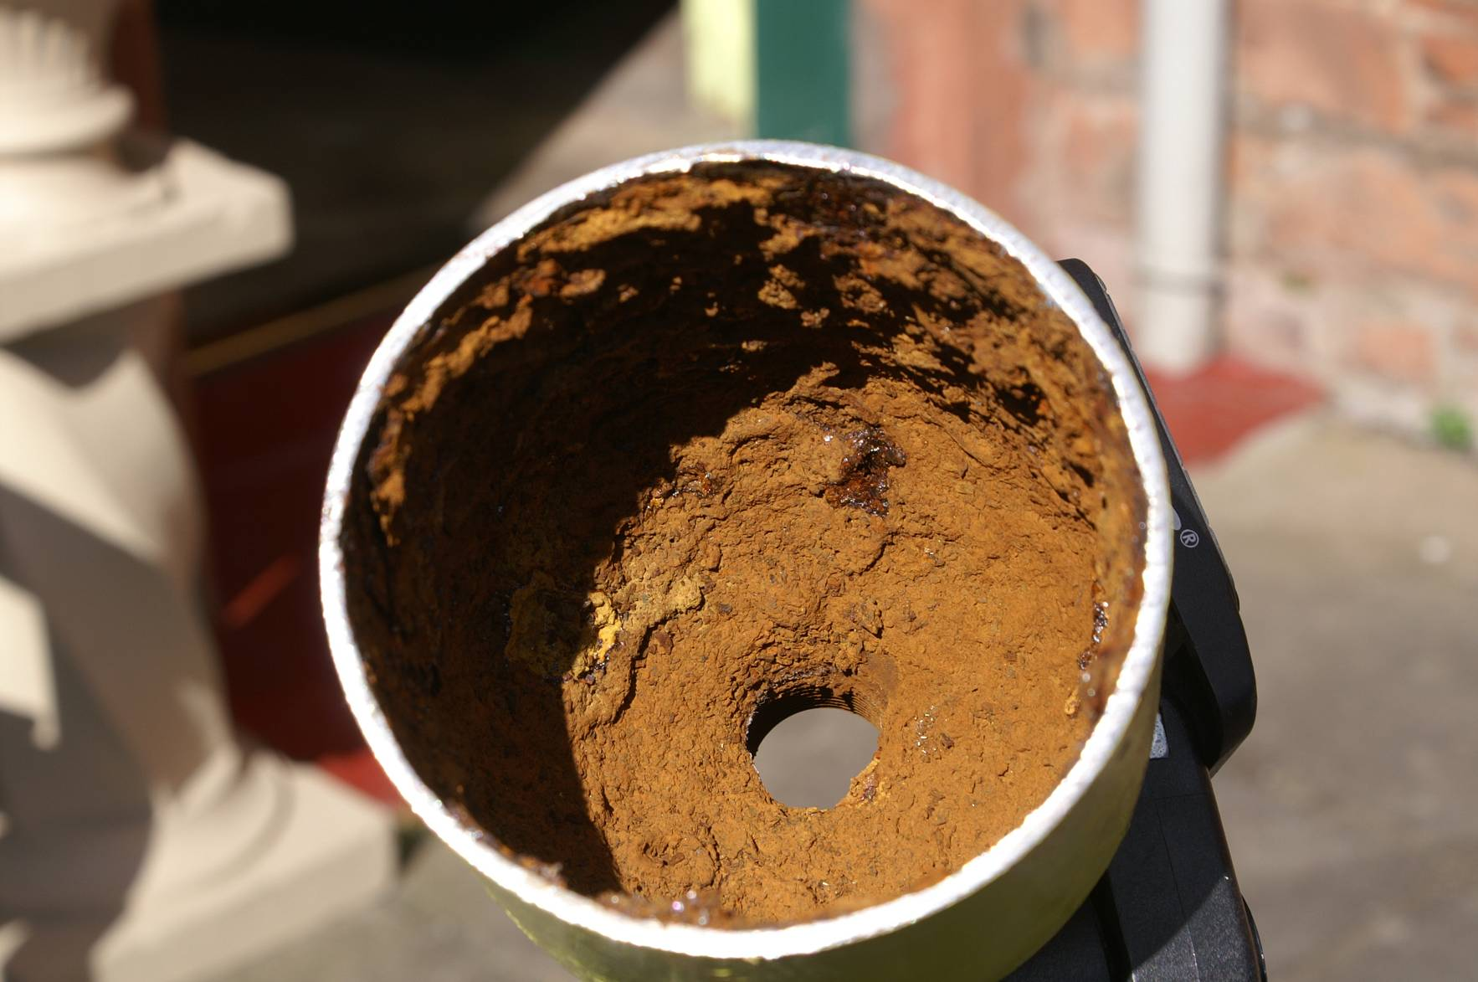
Cylinder Test 2

Slide 8
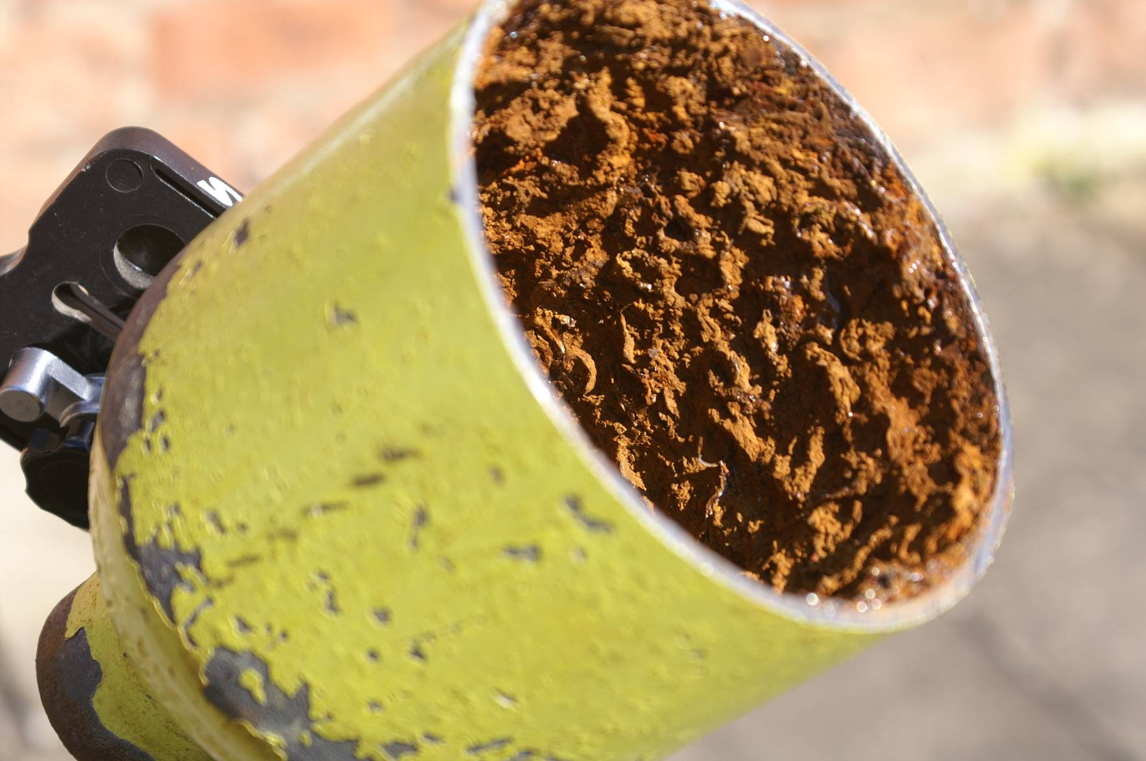
Cylinder Test 2

Slide 9

Cylinder capacity
How much air does a cylinder hold?
  Size of cylinder (litres) x contents (bar)
  E.g a 10 litre cylinder reading 200 bar has
      10x200=2000 litres of air
Calculate the following examples:
150
300
200
100
300
300
3 litre
7 litre
12 litre
15 litre
Twin 10 litres
450 litres
2100 litres
2400 litres
1500 litres
6000 litres

Slide 10
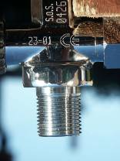
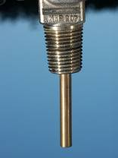
Pillar Valves
Cylinders are usually fitted with a parallel pillar valve, though older ones may be fitted with a tapered valve
Parallel
Tapered
© Dons Dive Store

Slide 11
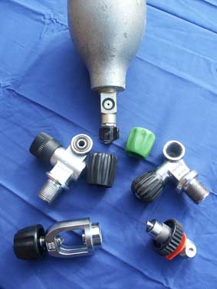
Pillar Valves
A -Clamp
  suitable for pressures up to 232 bar
  Before fitting a regulator to an A clamp check the O ring is properly seated
DIN
  suitable for pressures up to 300 bar
  Smaller, more compact, safer connection as the o-ring is enclosed within the pillar valve
Converters
© Dons Dive Store

Slide 12
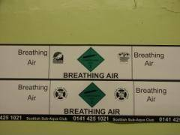
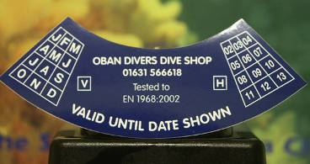
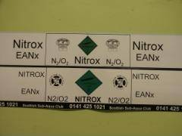
Cylinder test stickers
All cylinders will have an indication of their last test date stamped on neck of cylinder
All cylinders must display a sticker indicating the gas contained within it (e.g. Breathing Air, Nitrox)

Slide 13
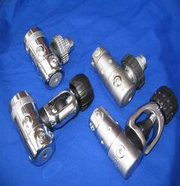
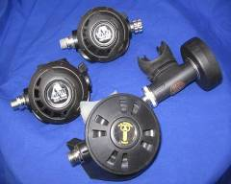
Regulators
Regulators consist of:
  1st Stage- regulates air from the cylinder at high pressure to intermediate pressure (8-12 bar)
  2nd Stage-regulates air from intermediate to ambient pressure. It allows the diver to breathe gas ON DEMAND
  Contents gauge, connected to a HIGH PRESSURE (HP) outlet on the 1st stage, tells the diver the pressure of remaining air in the cylinder (usually in bar)
  LOW PRESSURE (LP) outlets on the 1st stage are also provided to allow for connection of direct feeds to suit and BC. These are supplied at intermediate pressure

Slide 14
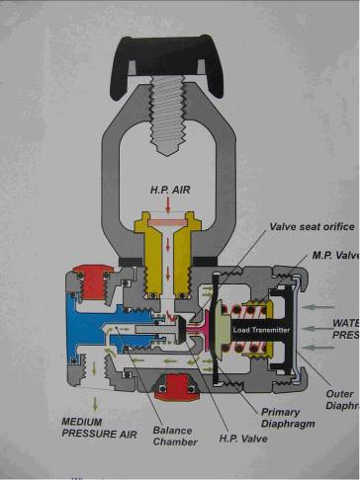
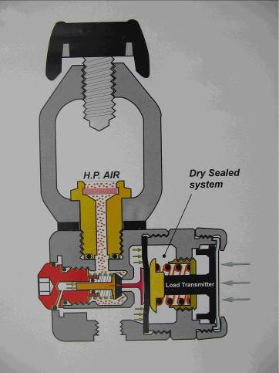
Workings of a First Stage
Source; Apeks Marine

Slide 15
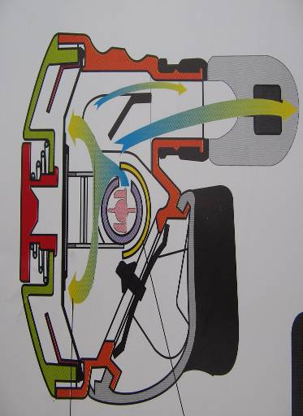
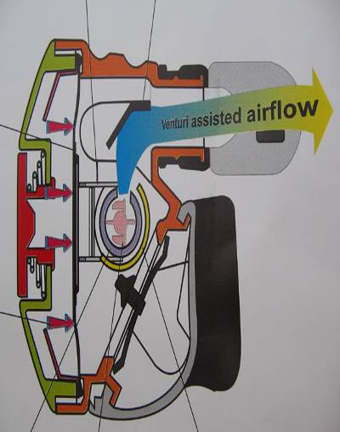
Workings of a Second Stage
source Apeks Marine

Slide 16
Alternate Air Sources
An alternate air source (AAS) can be used to provide air to a diver or buddy in the event of air loss or equipment failure
This backup should allow for a controlled ascent by both buddies without the need to share a single regulator
There are a variety of AAS available, appropriate to different levels of diving and equipment factors

Slide 17
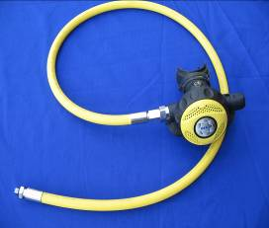
Types of AAS
Octopus
  Additional second stage on primary cylinder
  Resist the temptation to use a cheaper 2nd stage as an octopus as it may affect the performance of your valve
© Dons Dive Store

Slide 18
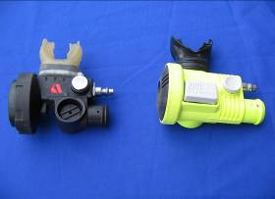
Types of AAS
BCD Demand Valve
  Regulator incorporated within BCD inflator
© Dons Dive Store

Slide 19
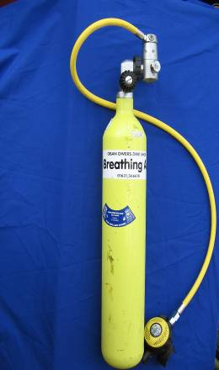
Types of AAS
Pony Cylinders
  Additional independent cylinder (usually 3ltr) with dedicated first and second stage
© Dons Dive Store

Slide 20
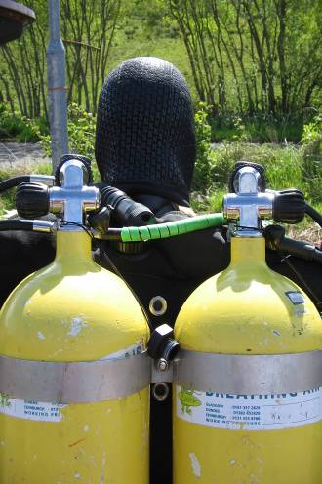
Types of AAS
Independent Twin Cylinders
  Two equal sized cylinders, each with dedicated first and second stages
© Dons Dive Store

Slide 21
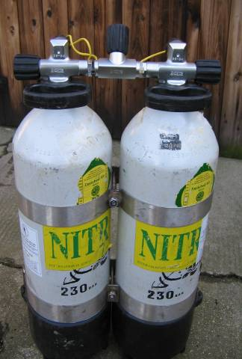
Types of AAS
Manifolded Twin Cylinders
  As above, joined via manifold bar. Some also allow for isolation in the event of equipment failure
© Dons Dive Store

Slide 22
Summary
Principles of the Aqualung
  Cylinder
  Regulator
Cylinder Capacity
Alternative Air Sources

Slide 23
The End
Thank you for your attention
Any questions?

Slide 24
Please provide any feedback on these slides to hq@scotsac.com
Thanks.

